Slide 1

Mykhailo Kuznietsov
Hi guys, I'm Mike.
I'm switcher and I'm 39 y.o.
All of my life I'm studying.
Some facts about me:
- I have degrees in Management and Engineering, and I know how works all of the main systems of Boeing 737
- I love to solve tasks. I solved all 4 volumes of Scanavi
- Now I work with bots and AI
- I don't have the best memory, so I have to understand how processes work.
I sincerely do not understand why people want to do the same work, if in our time any work can be automated…

Slide 2
DevOps_Q4_KY_Mykhailo Kuznietsov
CI-CD pipline.
Deploying of index.html file to the Virtual Machine Web Server

Slide 3
1. Motivation: This work is an option for me to put all of my DevOps knowledge together. It is my first CI/CD project. Not very complicated but totally operative.
2. Actuality – Using Jenkins and Github together allows us to deploy the simplest pipline for delivering an artifact to deployment. This approach allows us to deploy the work of the product development team as quickly as possible.
3. Goal – Provide an automated process for delivering and deploying of new code or any code changes
4. Tasks -
- Instances creation, configuration
- Network setup
- Install Jenkins, configuration.
- Create a repository on Git-Hub and link it to Jenkins (GithubWebhook)
- Creation of Jenkins pipline job
5. Implementation (no testing). Changes received on Github are automatically pushed to Jenkins. Jenkins sends changes to the web server
Conclusions: Automation of my project at the very beginning. As servers quantity will increase, there will be a lot of repetitive work. To create instances (AWS or Vbox), I will use Terraform. For group configuration of different platforms, I will use Ansible. Now my project is at the stage of connecting Ansible and Jenkins). Docker next

Slide 4
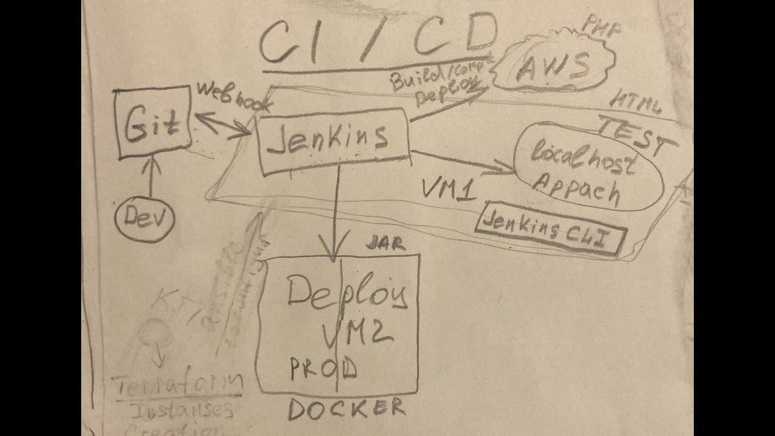
CI/CD

Slide 5
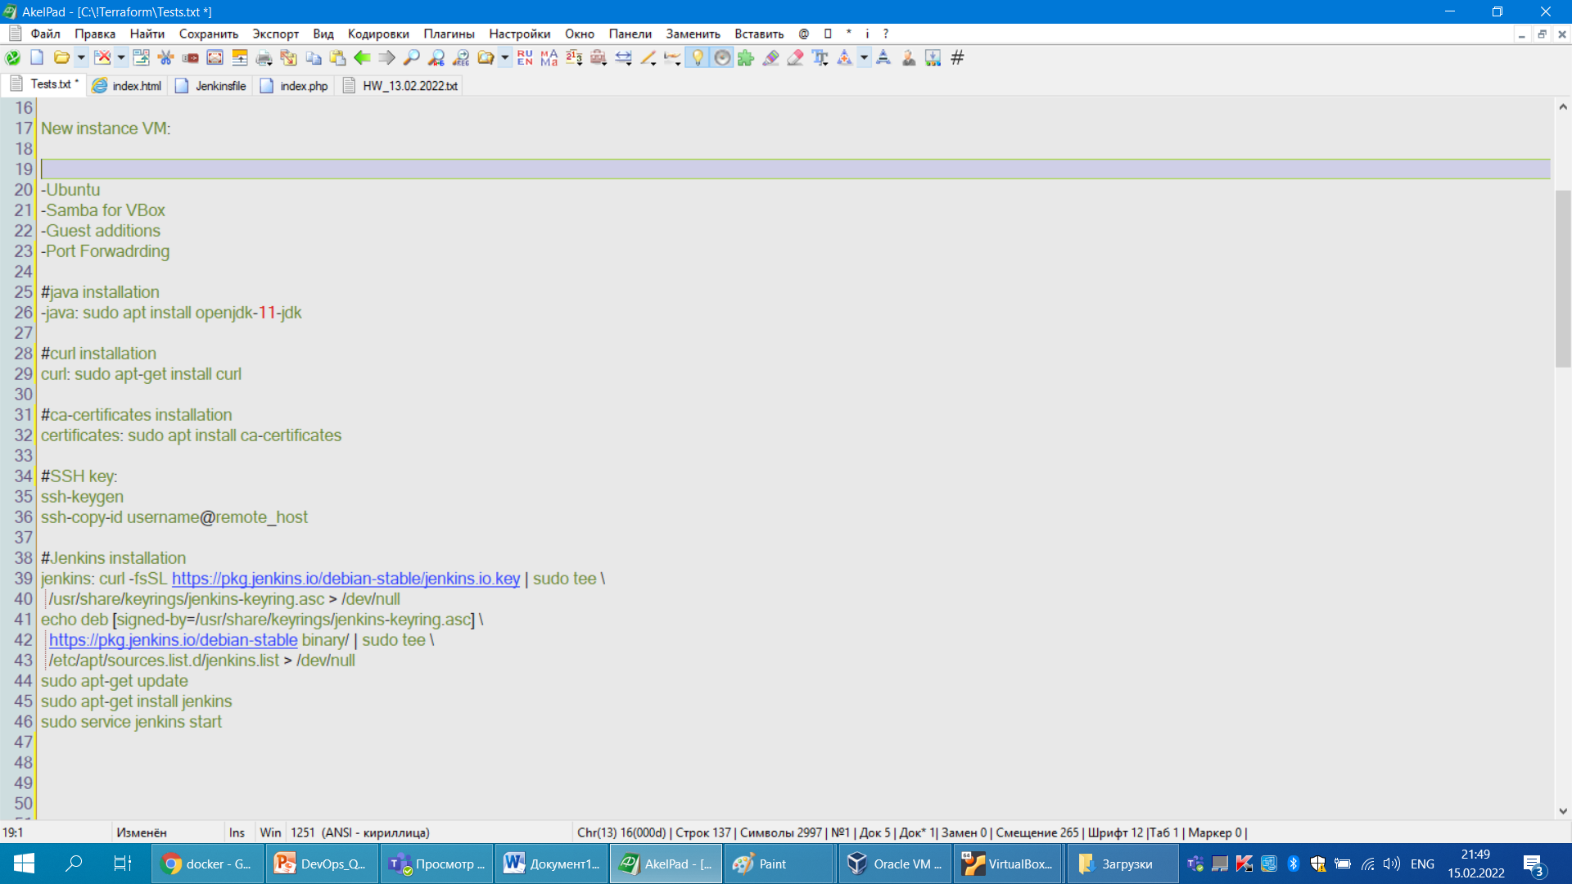
Settings for Virtual Machine, SSH, Jenkins on VM1

Slide 6
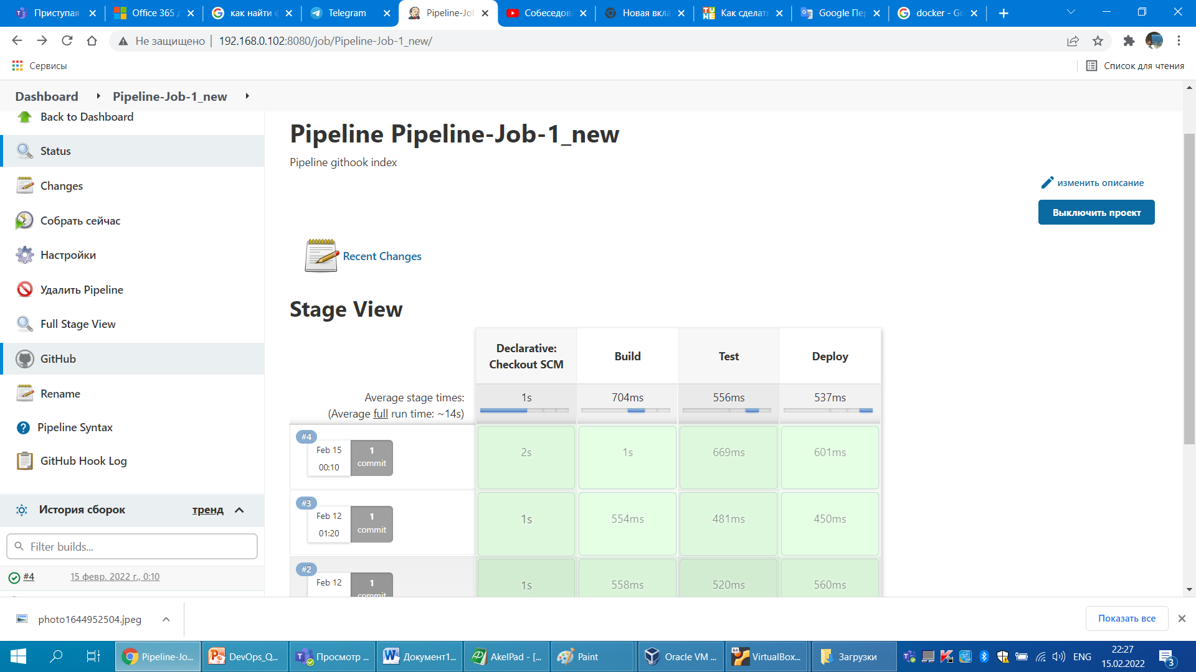
Pipeline job

Slide 7
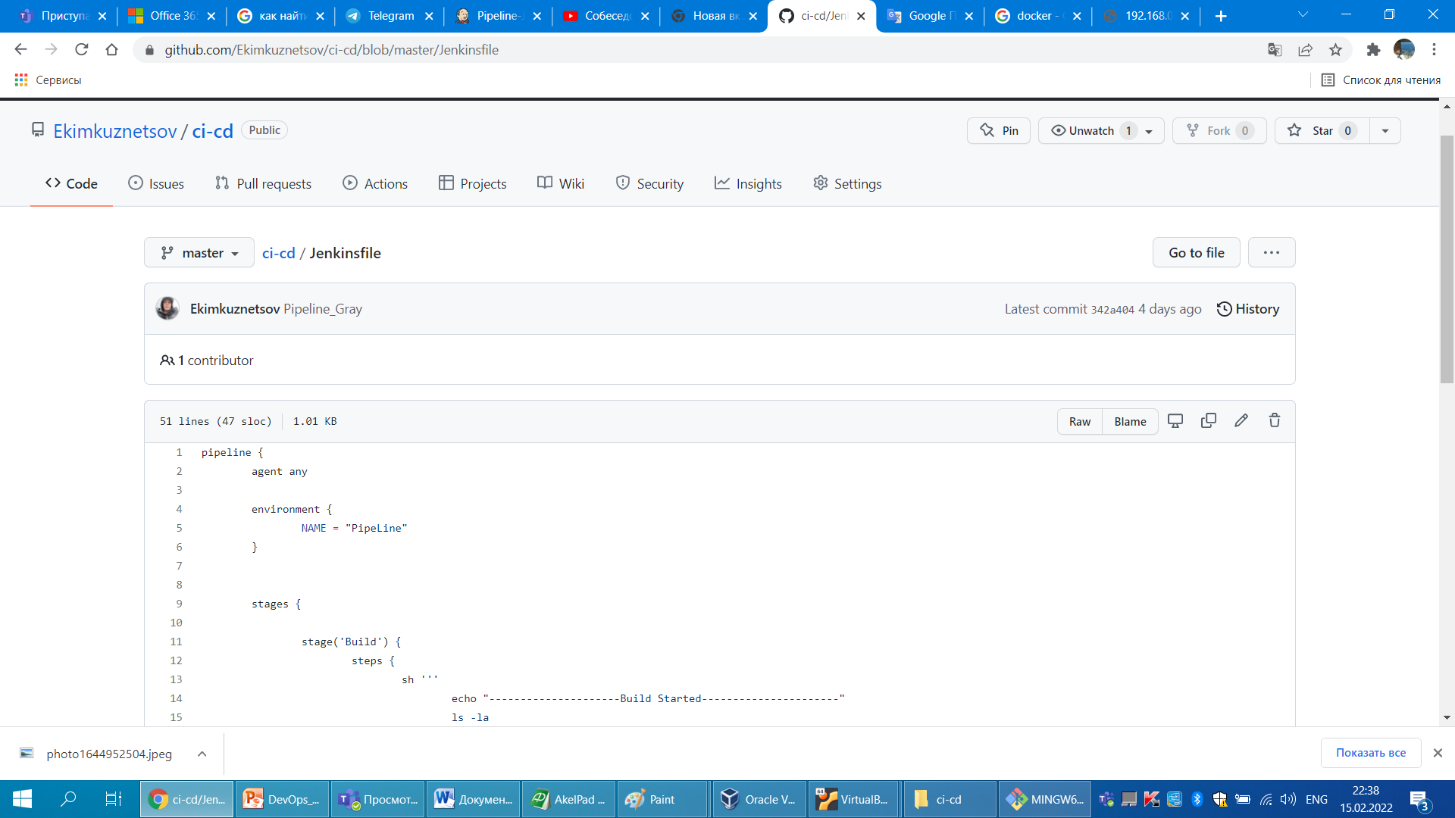
Jenkinsfile

Slide 8
